Slide 1
RCamp: Introductory Applied Statistics

Slide 2
Tribal-State Relations Acknowledgment Statement
The State of Minnesota is home to 11 federally recognized Indian Tribes with elected Tribal government officials. The State of Minnesota acknowledges and supports the unique political status of Tribal Nations across Minnesota and their absolute right to existence, self-governance, and self-determination. This unique relationship with federally recognized Indian Tribes is cemented by the Constitution of the United States, treaties, statutes, case law, and agreements. The State of Minnesota and Tribal governments across Minnesota significantly benefit from working together, learning from one another, and partnering where possible.​
Minnesota Department of Health recognizes, values, and celebrates the vibrant and unique relationships between the 11 Tribal Nations and the State of Minnesota. Partnerships formed through government-to-government relationships with these Tribes will effectively address health disparities and lead to better health outcomes for all of Minnesota. ​
In our work at the Office of Data Strategy and Interoperability, we demonstrate our commitment to Tribal-State relations by providing free assistance upon request and promoting health equity in data collection and use.​

Slide 3
Purpose of DSI
To provide vision, direction, and leadership in advancing data strategies and data exchange across MDH through:
Coordinating and streamlining the exchange of data with MDH
Overseeing and supporting state solutions and common tools
Facilitating efforts to maximize MDH data by creating data and process standards and tools with the whole Minnesota Public Health System in mind
Notes:
The purpose of DSI is to provide vision, direction, and leadership across MDH. We accomplish this by streamlining data exchange between MDH and outside partners, including LPH, advocating for common tools and standards within and with MDH, and working toward solutions that help LPH access and use MDH data for their work.

Slide 4
Vision of DTA
To support data needs for ALL staff in:
MDH
Local Public Health
Tribal Health
Data needs we support:
Project planning and design
Data wrangling and analysis
Data visualization and report preparation
Data literacy
Notes:
The vision of our unit is to support a range of data needs for ALL government staff working in public health in Minnesota. If you are familiar with the data lifecycle, we referenced that when determining what we could support. We support project design and conceptualization, data cleaning and validation, data analysis, and data visualization. We also provide general support through venues like trainings and communities of practice.

Slide 5
Acknowledgments
Thank you to the State of Minnesota R user group!
Special thanks to our founders Barbara Monaco, Dorian Kvale, Derek Nagel, and Kristi Ellickson.

Slide 6
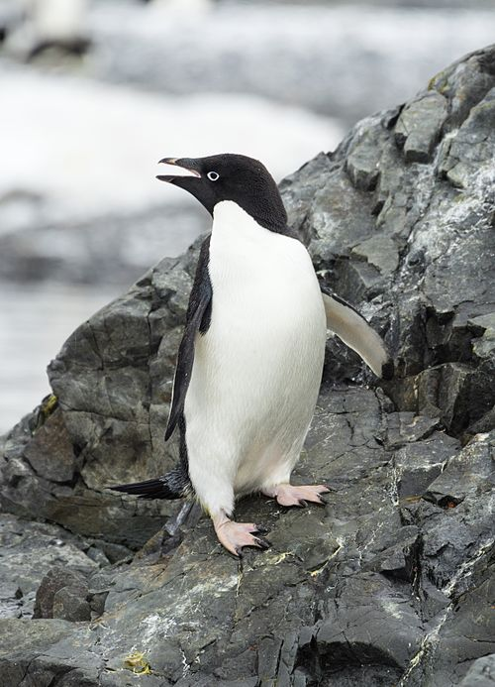
Introductory Applied Statistics Overview
Today we will cover:
Types of data, summary statistics, and distributions
Hypothesis testing and P-value
T-tests, Mann-Whitney U Test, Wilcoxon Signed Rank Test
ANOVA
Chi-Squared Test
Correlation
Linear Regression

Slide 7
Types of Quantitative Data
Continuous data
Data that can take on any value within a given range, including decimals and fractions (height, weight, temperature)
Might or might not be normally distributed
We will mostly focus on continuous data today
Discrete data
Data that can only take on specific, separate values, typically whole numbers or categories
Binary data: discrete data with only two possible outcomes (e.g. dear or alive, sick or healthy)
Counts: whole numbers representing the number of events, patients, hospitals, or anything else that can be counted
Nominal data: data categories with no order (blood type, treatment group)
Ordinal data: data categories with a particular order (pain scale, survey response categories)

Slide 8
Summary Statistics
Summary statistics summarize and provide information about your sample data.
Summary statistics fall into three main categories:
Measures of location: where your data is centered at, or where a trend lies
Mean, median, mode
Measures of spread or distribution shape: how spread out or varied your data set is
range, standard deviation, skew and kurtosis
Graphs/charts: ways to display summary data
histogram, frequency distribution table, box plot, bar chart, scatter plot and pie chart

Slide 9
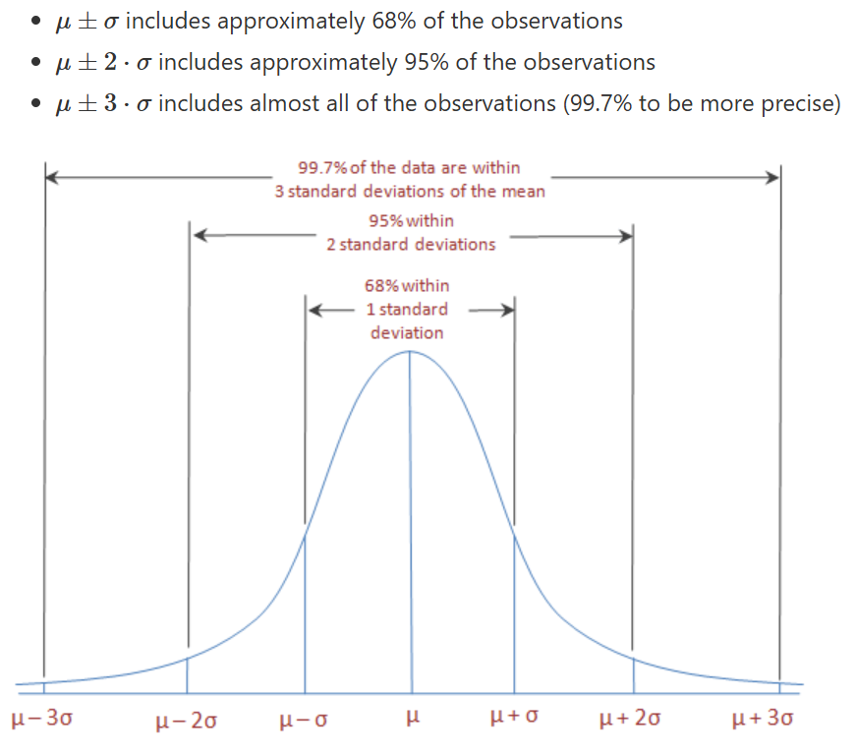
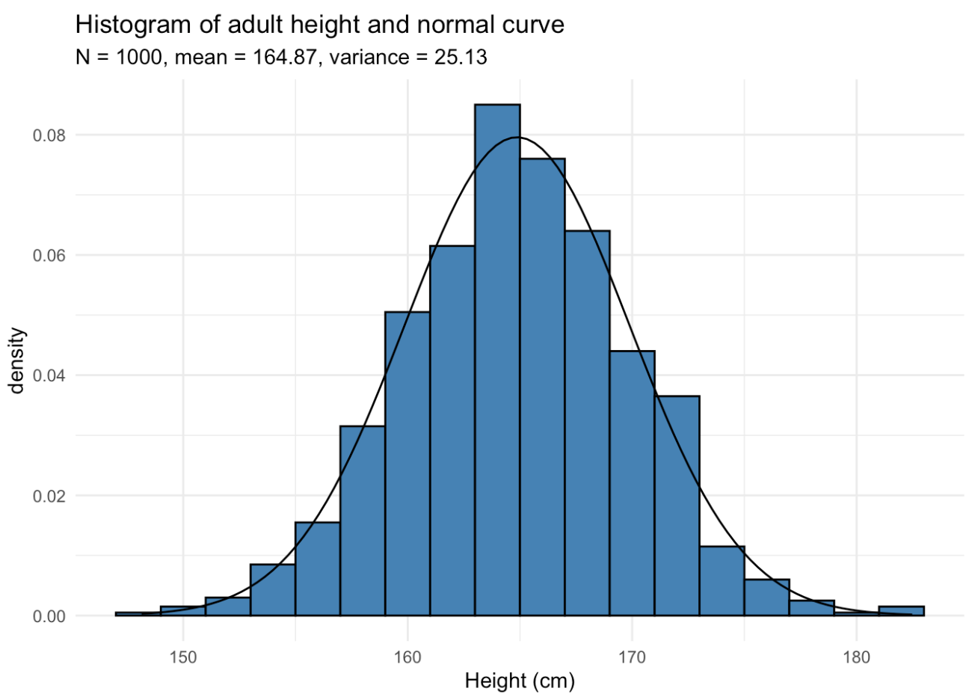
Normal Distribution
https://statsandr.com/blog/do-my-data-follow-a-normal-distribution-a-note-on-the-most-widely-used-distribution-and-how-to-test-for-normality-in-r/

Slide 10
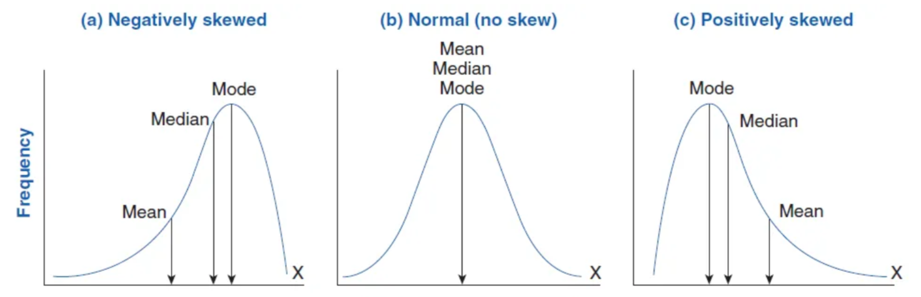
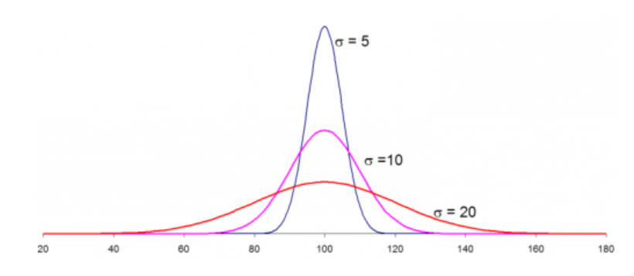
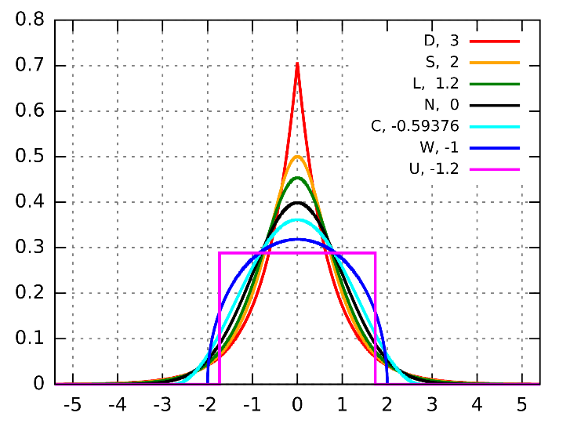
Skew, Standard Deviation, and Kurtosis
Various standard deviations
Various levels of kurtosis with the same sd

Slide 11
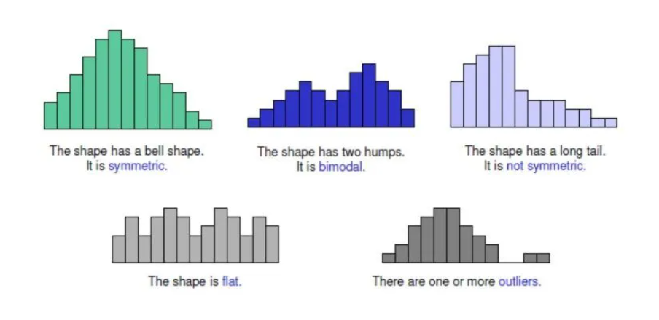
Non-Normal Distribution
https://leanscape.io/data-distributions-explained-what-are-the-different-types-of-distribution/
Notes:
For many statistical tests, normal distribution is required in order to get accurate results!

Slide 12
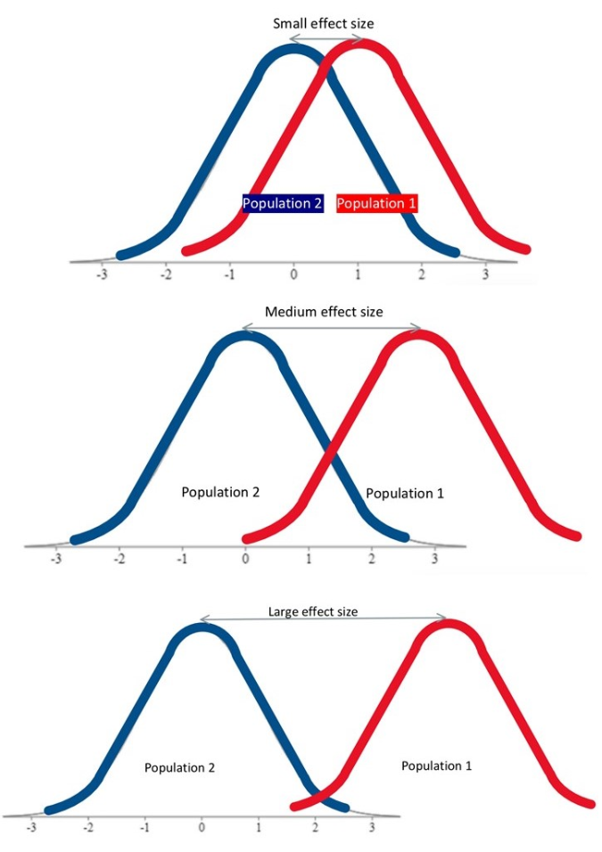
Hypothesis Testing and P-value
For example, we want to know if the average height between two groups of people is different or not
Null Hypothesis (H₀): There is no difference in average height between the two groups
Alternative Hypothesis (H_{A} or H₁): There is a difference in average height between the two groups
P-value (probability value) tells us how likely is the difference in height that we see if the null hypothesis is true (there is actually no difference)
A commonly accepted P-value for statistical significance is equal to or below α = 0.05
That means that 5% of the time the height difference that you see would be there by random chance even if the null hypothesis was true (error rate you are willing to accept)
You are 95% confident that there is a statistical difference in height between the groups
Notes:
P-value: probability of observing data as extreme (or more) than observed if H0 were true.
Significance level (α): a pre-set threshold (commonly 0.05) for declaring statistical significance.

Slide 13
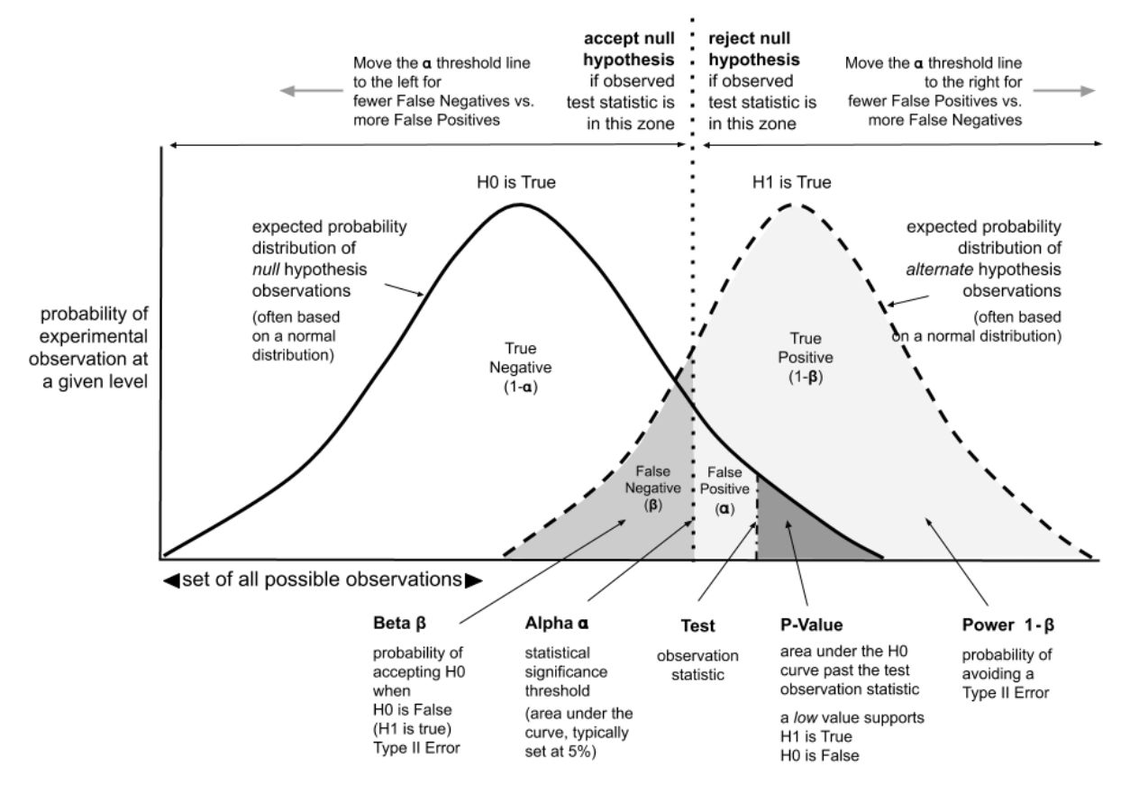
Error Types and Statistical Power
Type I error: incorrectly reject H₀ when it is true (false positive)
α is the probability of Type I error
Type II error: fail to reject H₀ when it is false (false negative)
β is the probability of Type II error
Power = 1 − β
Probability that a test will correctly reject the H₀
Visualization to explore:
https://rpsychologist.com/d3/nhst/
https://www.ml-science.com/statistical-power-of-a-test
Notes:
P-value: probability of observing data as extreme (or more) than observed if H0 were true.
Significance level (α): a pre-set threshold (commonly 0.05) for declaring statistical significance.

Slide 14
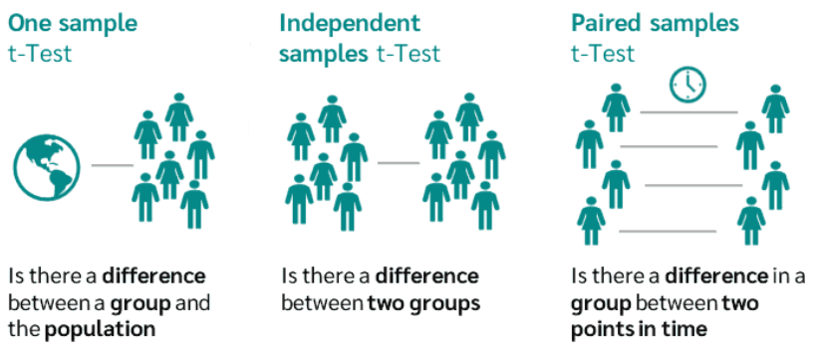
T-Test
Compares the means of two groups and tells whether the difference is significant
Lets you know the likelihood those differences could have happened by random chance (P-value)
Different kinds of t-tests:
A two tailed t-test checks whether there is a general difference between two groups.
A one tailed t-test checks whether one group is specifically larger or smaller (has a direction)
T-tests were first developed to test the consistency Guiness beer!
https://datatab.net/tutorial/one-sample-t-test
Notes:
A paired t-test assumes that there is less variability between the two measured groups, since it assumes that we are measuring the same subjects twice. By removing this variability that would usually exist if the groups were independent, we make the test more sensitive, and it often results in a lower p-value.

Slide 15
T-Test Assumptions
Assumptions are extremely important in statistics! Tests are only valid when all the assumptions are met.
The data is numeric and continuous
The data comes from a random, representative sample
The data is normally distributed
To formally test for normality, you can use the Shapiro-Wilks test. A p-value <0.05 suggests that the data is not normally distributed
The variance of data in both groups is approximately equal
The data in two groups is independent from each other (only relevant for the non-paired tests)
What if we can’t meet some of those assumptions?
https://datatab.net/tutorial/one-sample-t-test

Slide 16
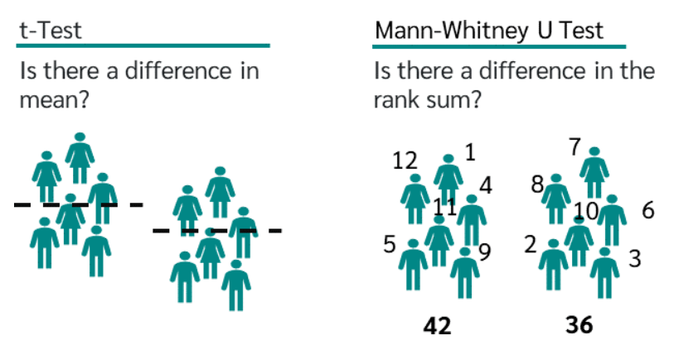
Mann-Whitney U-Test
If the data isn’t normally distributed, you can use the Mann-Whitney U-Test
The independent t-test counterpart for data that is not normally distributed.
Tests that require assumptions about data distributions are called parametric. Tests that do not are called nonparametric.
Instead of comparing groups directly, the test ranks everyone in both groups from shortest to tallest, sums the ranks in both groups, and compares this rank sum between the groups.
he
https://datatab.net/tutorial/mann-whitney-u-test

Slide 17
Wilcoxon Signed Rank Test
What if the data is not normally distributed but is paired?
Use the Wilcoxon Signed Rank Test, the nonparametric counterpart to the paired t-test
Works just like the Mann-Whitney u-Test by comparing rank sums
There are more types of tests for different situations, but these are some of the most common when comparing two groups or one sample group and the general population.
What if you want to compare more than two groups at a time?

Slide 18
ANOVA
•Analysis of Variance (ANOVA) can be used to compare the means of more than two groups at a time
•One-way ANOVA compares one variable across multiple categories
Example: Average disease duration in three cohorts receiving different treatment
•Two-way ANOVA compares two variables across multiple categories, as well as their interaction
Example: Average disease duration in three cohorts receiving different treatment and accounting for patient sex
 | Men | Women
Cohort 1 | 9 days | 10.2 days
Cohort 2 | 7.2 days | 7.0 days
Cohort 3 | 5.6 days | 4.8 days

Slide 19
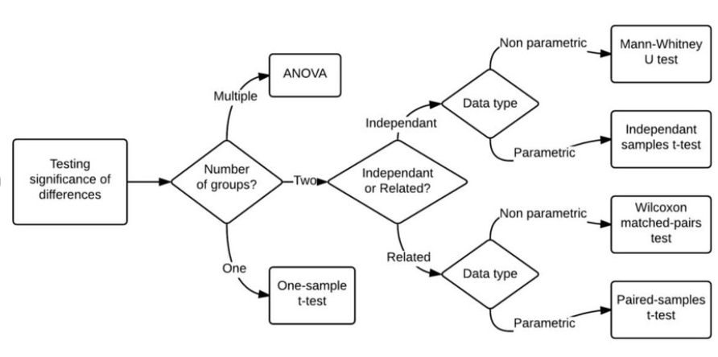
Statistical Test Decision Tree
Chaudy, Yaelle. (2015). An Assessment and Learning Analytics Engine for Games-based Learning. 10.13140/RG.2.1.4932.5040.

Slide 20
Chi-Square Test
If your data isn’t continuous but is instead categorical, you can use the Chi-Square test
Example: we want to tell whether out of a sample of 300 people, diabetes rates are different between men and women
H₀: Diabetes rate are the same
H_{A}: Diabetes rate are different
Assumptions:
Both datasets are categorial
Observations are independent
Each category (cell in the table) is mutually exclusive
Each value in the cell should be 5 or greater
 | Diabetes | No Diabetes | Total
Men | 43 | 114 | 157
Women | 34 | 109 | 143
Total | 77 | 223 | 300

Slide 21
Correlation
Correlation describes the linear relationships between quantitative variables.
Pearson correlation coefficient formulas (often shown as "r") are used to find the strength of a relationship between two normally distributed continuous variables. The formula returns a value between -1 and 1, where:
1 indicates a strong positive relationship.
-1 indicates a strong negative relationship.
A result of zero indicates no relationship at all.
Spearman correlation is used for data that is not normally distributed, is non-linear, or has significant outliers. Like other non-parametric alternative tests, it is based on rank rather than raw values

Slide 22
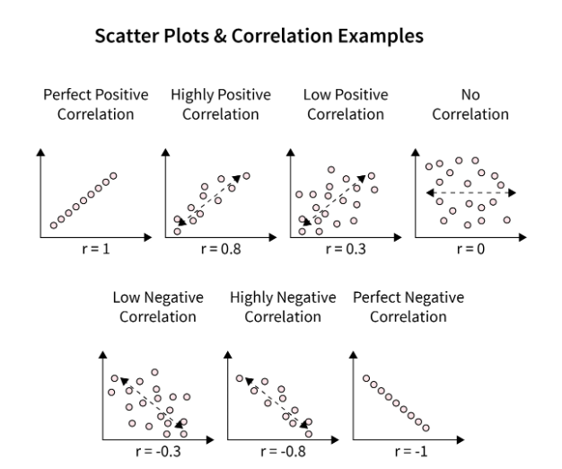
Correlation Visual Examples

Slide 23
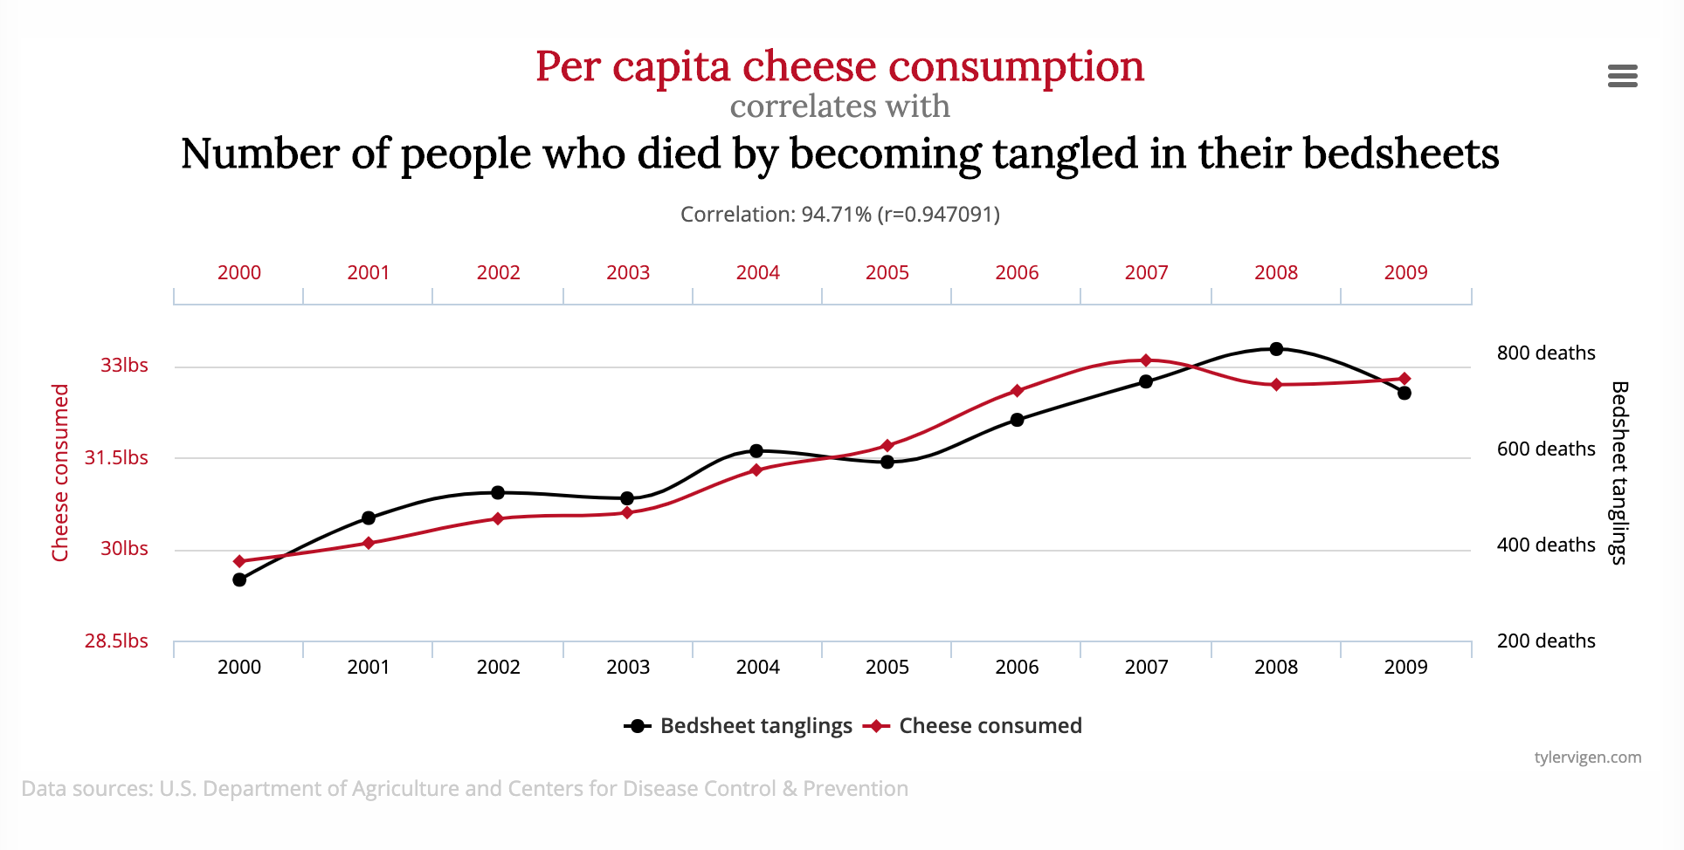
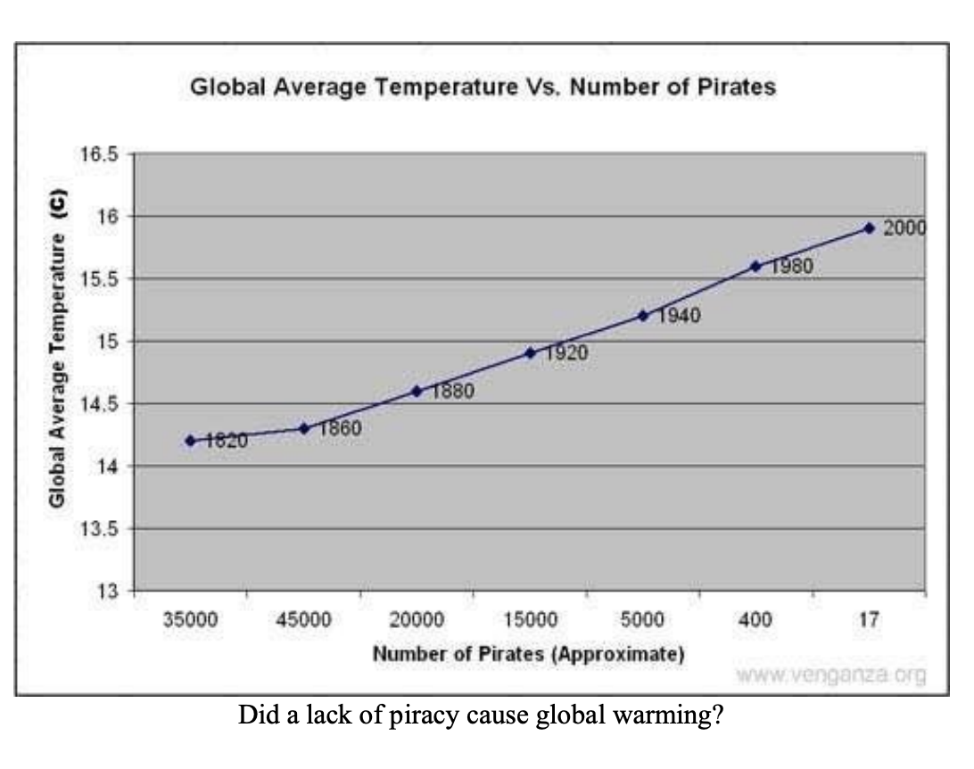
Correlation is not Causation
Correlation is not causation! just because two things correlate does not necessarily mean that one causes the other.

Slide 24

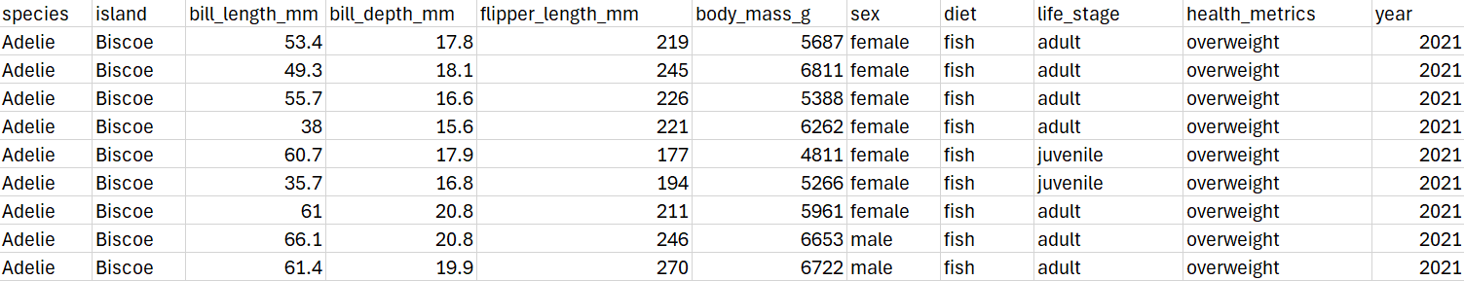
Palmer Penguin Dataset
Now let’s look how these kinds of tests can be run in R
This data was collected between 2007 and 2009 on the Palmer archipelago in the Antarctic
https://journal.r-project.org/articles/RJ-2022-020/

Slide 25
Regression Analysis
Regression analysis provides you with an equation for a graph so that you can make predictions or draw insight about your data.
Simple regression analysis uses a single x variable for each dependent “y” variable.
Multiple regression analysis is used to see if there is a statistically significant relationship between sets of variables. It’s used to find trends in those sets of data.
Regression is often more powerful and flexible than many other statistical tests and is a staple of statistical analysis

Slide 26
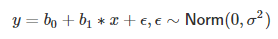
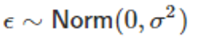
Linear Regression
Linear regression equation:
y – dependent variable
x – independent variable
b1 – slope
b0 – intercept
ε – the error term that represents all the variation in y that the model cannot explain
Linear regression error term is normally distributed
0 – the mean of the normal distribution
σ2 – standard deviation squared, also known as variance
Linear regression visualization: https://ryansafner.shinyapps.io/ols_estimation_by_min_sse/

Slide 27
Linear Regression Assumptions
The dependent variable (outcome) is continuous
The relationship between predictors (x) and outcome (y) is linear
The residuals of the regression (differences between observed and estimated values) are normally distributed
Note that the data itself does not have to be normally distributed
No multicollinearity: independent variables should not correlate with each other more than ~0.8
Homoscedasticity: the variance of the errors is constant across all levels of the independent variable
Error terms are independent of each other
Notes:
*Error dependence might be especially prevalent in time series data where earlier values influence future values

Slide 28
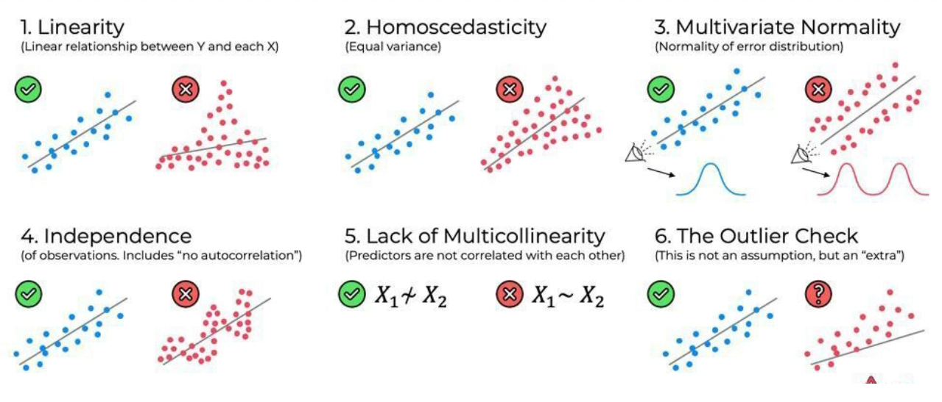
Linear Regression Assumptions
https://www.geeksforgeeks.org/machine-learning/assumptions-of-linear-regression/

Slide 29
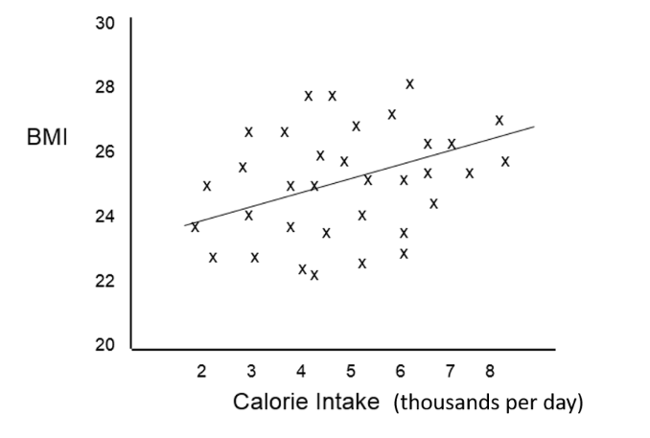
Multiple Linear Regression
Consider a hypothetical situation evaluating BMI and Calorie Intake. Multiple R squared value (a statistic to help assess the wellness of the regression fit) in this case was 0.12 , so caloric intake alone does not predict BMI well. What other variables could influence BMI? Perhaps activity level and gender?

Slide 30
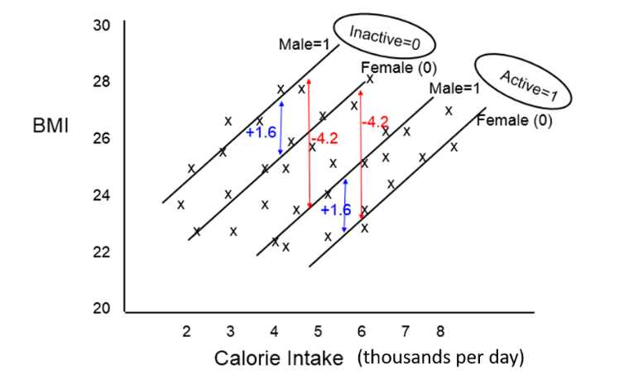
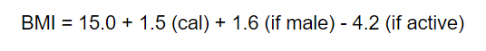
Multiple Linear Regression
The equation for this would be: What can be said about active and inactive populations as it relates to gender, calorie intake, and BMI? Solving this work by hand is very tedious, so we will use R Many additional variables can be added into the equation to improve the model outcome

Slide 31
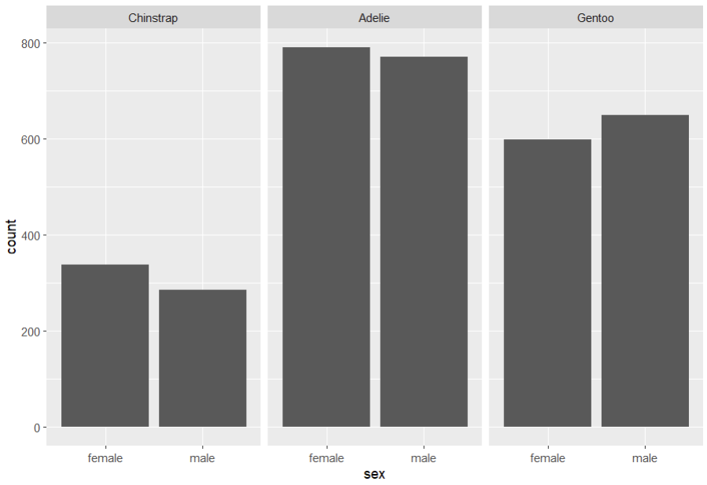
Exploring the Palmer Penguin Data
Number of penguins by sex and species
Notes:
It’s usually the best practice to start exploring your data via figures, tables, and graphs and only move on to statistics once you understand it well enough

Slide 32
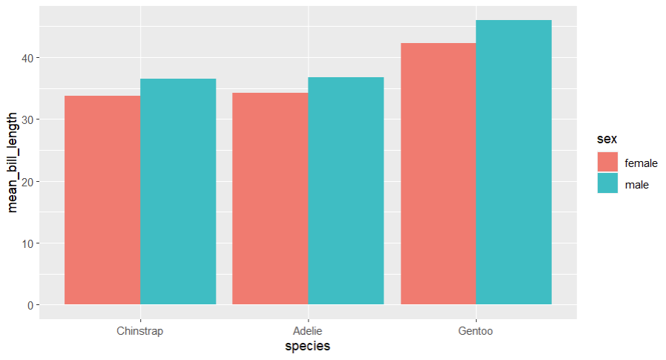
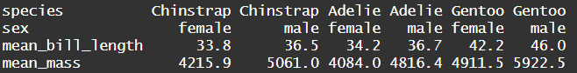
Exploring the Palmer Penguin Data
Notes:
A table can be more useful than a graph if you want to see specific numbers

Slide 33
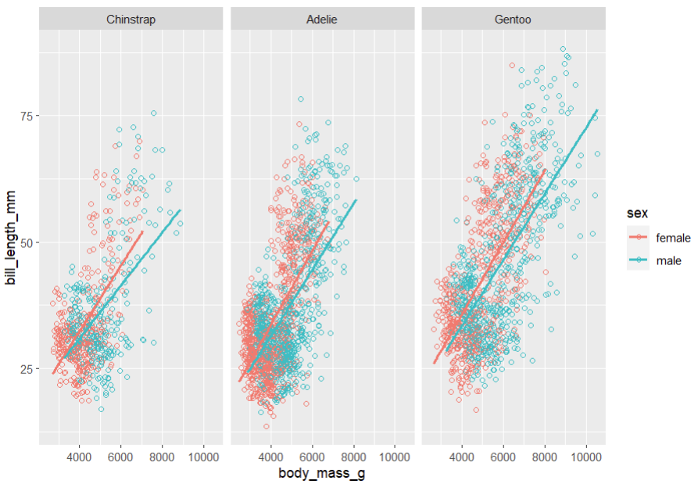
Exploring the Palmer Penguin Data
The relationship between penguin bill length, body mass, species, and sex
Notes:
Graphs like these can help visualize complex relationships and build hypotheses. Interpretations? It seems like the relationship between body mass and bill length varies by sex and species

Slide 34
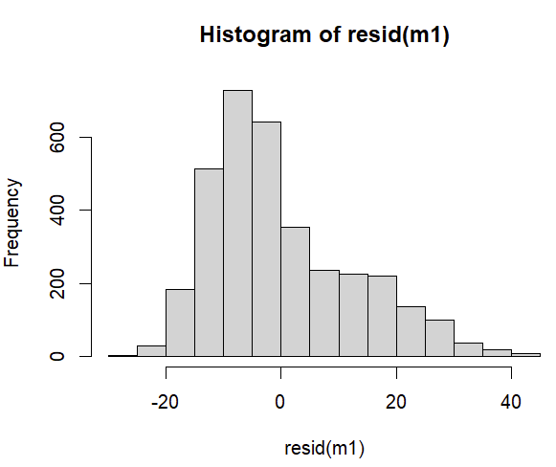
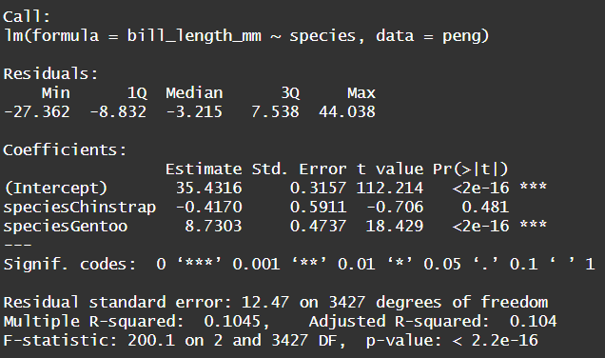
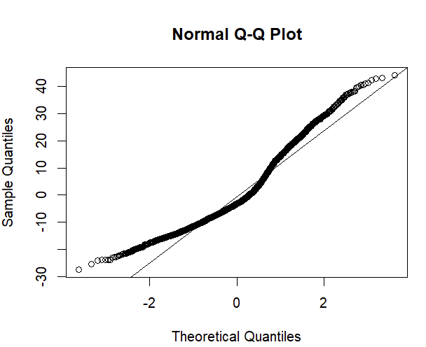
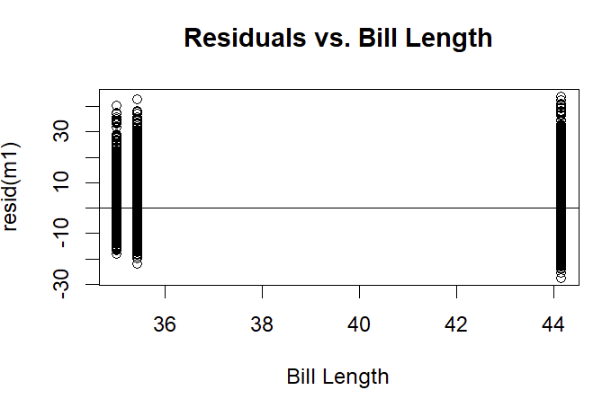
Linear Regression Interpretation 1
Notes:
Interpretation: mean bill length of Adeline is 35.4mm. Gentoo bill length is 8.73mm longer than Adeline, which is statistically significant at alpha = 0.05. The mean Chinstrap bill length is shorter than Adeline, but this difference isn’t statistically significant.
R-squared: the proportion of the variance of the dependent variable that can be explained by the independent variable. It is 0.104, so only about 10% of the bill length is explained by the species of penguin. Multiple R-squared always increases with additional variables, so Adjusted R-squared is generally a better statistic to consider. Regression models should aim to be parsimonious.
QQ-plot and histogram both show that the residuals aren’t quite normally distributed. QQ-plot plots the quantiles of the residuals against a theoretical distribution. It is best if it is a straight line.
Shapiro-Wilk test might be useful to formally test the normality of these residuals.
Residuals vs Bill Length is showing the bill length on the x-axis, and how residuals are dispersed for the tree species (three vertical lines). The variance of the residuals is fairly constant, which is good.

Slide 35
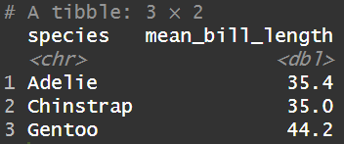
Exploring the Palmer Penguin Data
Which species should serve as the reference category for the regressions?

Slide 36
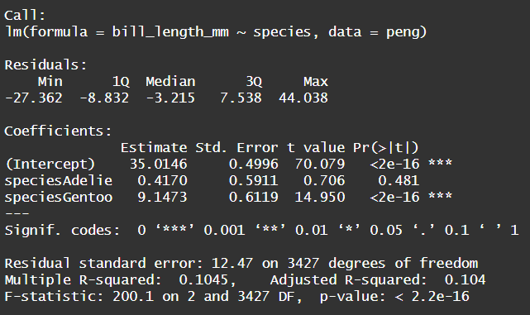
Linear Regression Interpretation 2
Notes:
Average Chinstrap bill length is 35.01mm. The length of Gentoo beak is 9.15mm longer than Chinstrap, which is statistically significant at alpha = 0.05. Adelie bill length isn’t statistically significantly different from Chinstrap.

Slide 37
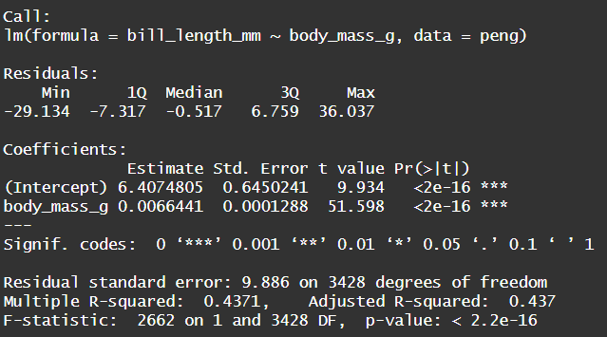
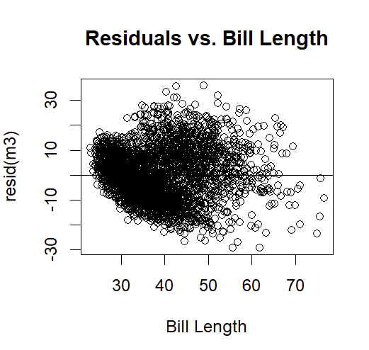
Linear Regression Interpretation 3
Notes:
What does the intercept 6.407 mean? Does this have scientific significance?
It is the average length of the bill of all the species in mm if the penguin weighed 0 grams. It’s not a scientifically meaningful value.
For every increase of a penguin’s mass by one gram, their beak length increases by 0.0066mm.
It is better to multiply the coefficients and say that for every increase of a penguin’s mass by one kilogram, it’s bill length increases by 6.64mm
The residuals look fairly normally distributed, but what might be an issue? Could heteroscedasticity be a problem?
Could try transforming the data, or consider non-parametric regressions that we will not cover here.

Slide 38
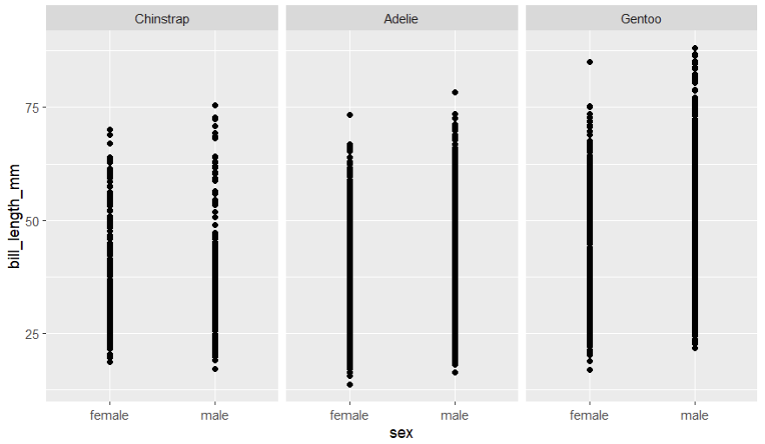
Bill Length by Species and Sex
Notes:
Seems like males might have longer bills in Adelie and Gentoo, and not for Chinstrap, but it is difficult to tell

Slide 39
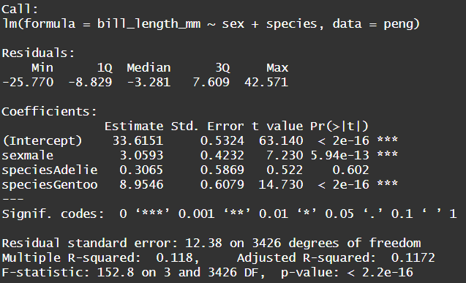
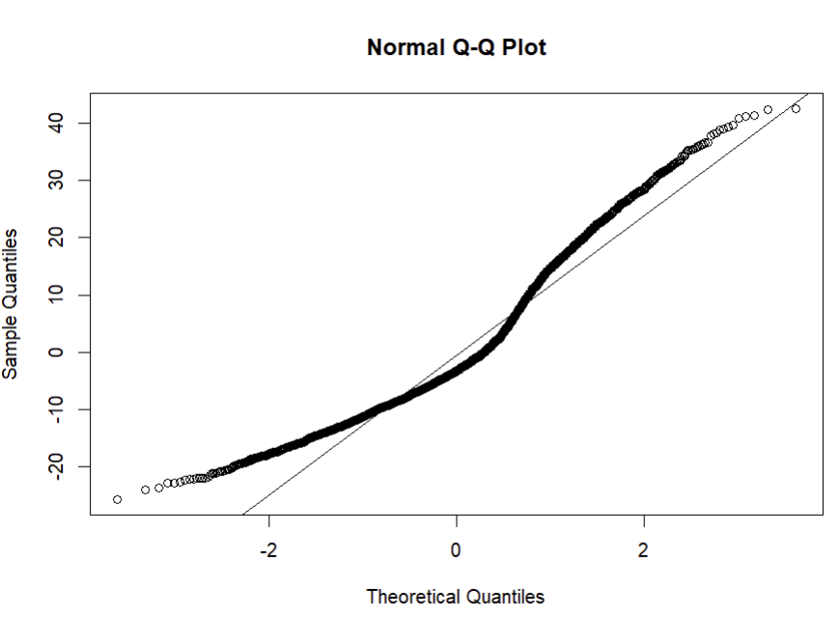
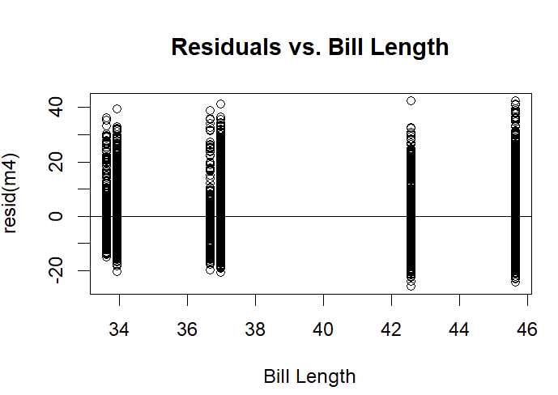
Linear Regression Interpretation 4
Notes:
33.61mm is the bill length of Chinstrap females. The bill length of males of all species is on average 3.06 mm longer than the bills of females (this difference is statistically significant). Bill lengths of all Adelie are 0.307mm longer than bill lengths of Chinstrap females, but this difference isn’t significant. Bill lengths of all Gentoo is 8.95mm longer than female Chinstrap bill lengths, which is statistically significant.
QQplot is not very normal..

Slide 40
Exploring the Palmer Penguin Data
Is it possible that the difference in the bill length between females and males varies by species?

Slide 41
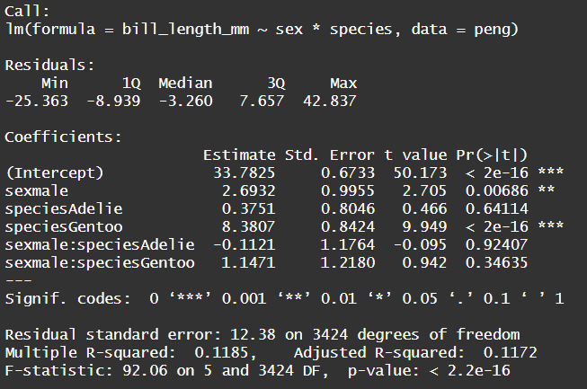
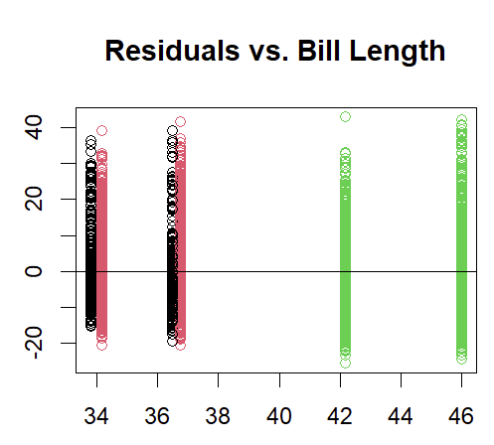
Linear Regression Interpretation 5
Notes:
33.78mm – bill length of Chinstrap females. Average length of bills of male Chinstrap is 2.69mm longer, than in Chinstrap females. Bill lengths of female Adelie are 0.375mm longer than bill lengths of female Chinstraps, but this difference is not significant. Bill lengths of female Gentoo are 8.38mm longer than bill lengths of female Chinstrap, which is statistically significant.
-0.1121: difference in bill length between male Adelie and female Adelie is 0.1121mm less than difference in bill length between male Chinstrap and female Chinstrap. But this difference in difference is not significant.
1.147: difference in bill length of male and female Gentoo is 1.147mm bigger, than difference in bill length between male and female Chinstrap, though it’s also not significant.
Average bill length of female Adelie: 33.783+0.3751 = 34.16
Average bill length of male Adelie: 33.783+2.693 + 0.3751 – 0.1121 = 36.739
Average bill length of female Gentoo: 33.78+8.3807 = 42.161
Average bill length of male Gentoo: 33.78+2.69 + 8.3807 + 1.1471 = 45.99

Slide 42
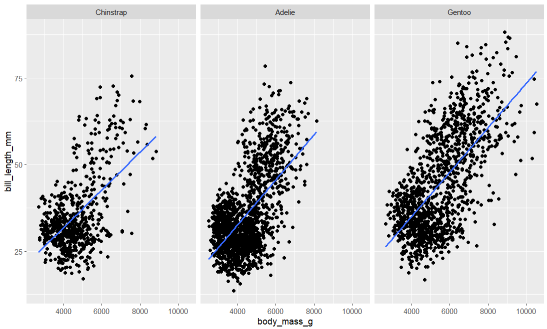
Species, Body Mass, and Bill Length
Notes:
If we look at species, mass, and beak length together, we can see that Gentoo generally might be larger and have a longer beak.

Slide 43
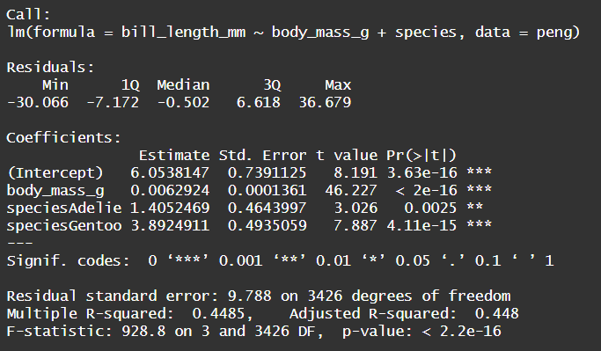
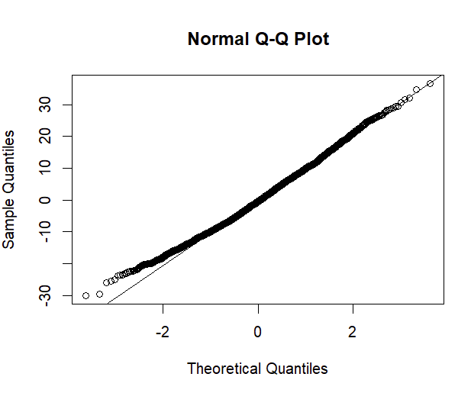
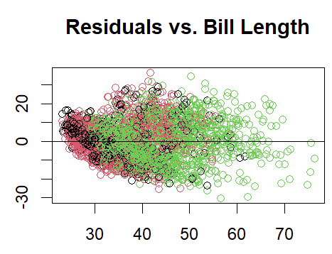
Linear Regression Interpretation 6
Notes:
6.054 – bill length of Chinstrap at 0 grams of mass
Bill length of all species of penguins increases by 6.29mm for every kilogram of gained weight, which is statistically significant.
Adelie bill length is 1.405mm longer than Chinstrap bill length when both are at 0 grams of mass, while Gentoo bill length is 3.89mm longer at 0 grams of mass.
Does it make sense to discuss these specific differences? No, since 0 mass penguins do not exist.
This model assumes that the change in bill length relative to body mass for all species is the same. However, this might not be the case!
Residuals QQplot looks normal. The species-specific vertical lines in the residual vs bill length graph are gone since they are masked by the continuous measures of the body mass

Slide 44
Species, Body Mass, and Bill Length
Notes:
Is there any way we could make this graph a bit easier to read?

Slide 45
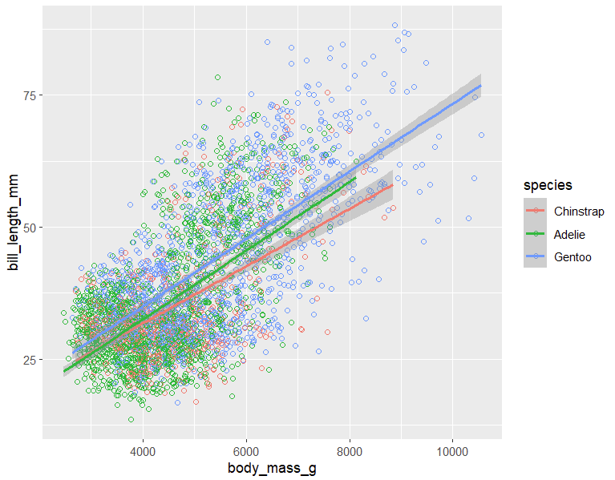
Species, Body Mass, and Bill Length Plotted Together
Notes:
By plotting the graphs over each other, we can see that different species have slightly different slopes in the relationship between body mass and bill length

Slide 46
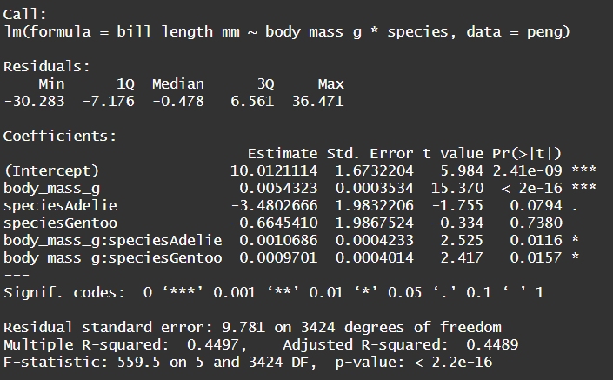
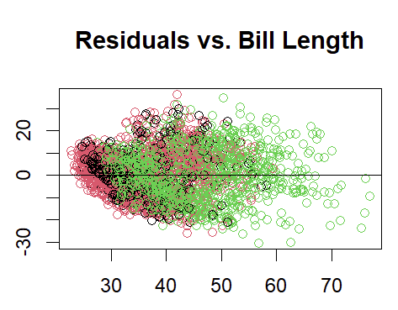
Linear Regression Interpretation 7
Notes:
10.01 – bill lengths of all Chinstrap at 0g mass
Chinstrap bill length increases by 5.4mm for every kilogram it gains, which is statistically significant
Adelie bill length is 3.48mm shorter than Chinstrap bill length at 0g, while Gentoo bill length is 0.66mm shorter, though neither are significant
For every gained kilogram of mass Adelie bill length increases by 1.07mm more than the bill of Chinstrap for every kilogram it gains (statistically significant)
For every gained kilogram Gentoo bill length increases by 0.970mm more than the bill of Chinstrap for every kilogram it gains (statistically significant)
What will be the beak length of a 6.5kg Gentoo? 10.01– 0.664 + (0.0054+0.0009701)*6500 = 50.7

Slide 47
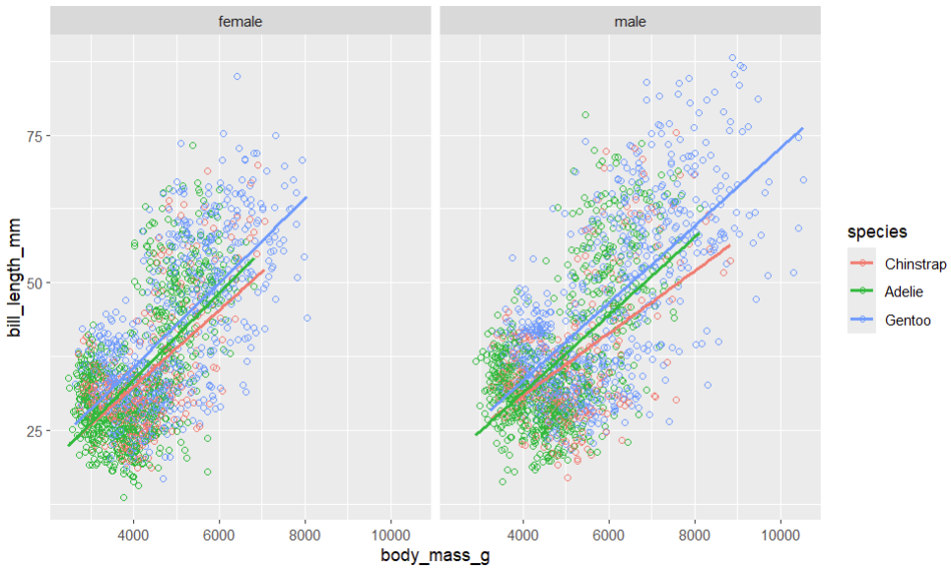
Species, Body Mass, and Bill Length separated by Sex
Notes:
Interpretations?

Slide 48
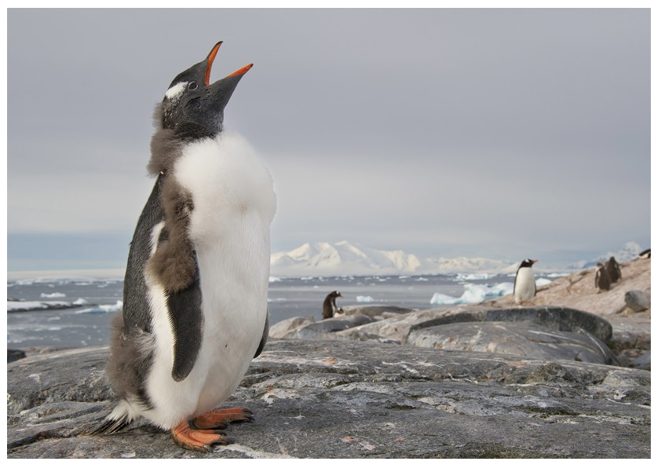
Questions?
Notes:
Interpretations?

